Slide 1

Database Applications
U01C03 | Mr Butler

Slide 2

Databases
What actually is a database?

Slide 3

Databases
A (large) collection of data items and links between them, structured in a way that allows it to be accessed by a number of different application programs.
The term is also used loosely to describe any collection of data

Slide 4
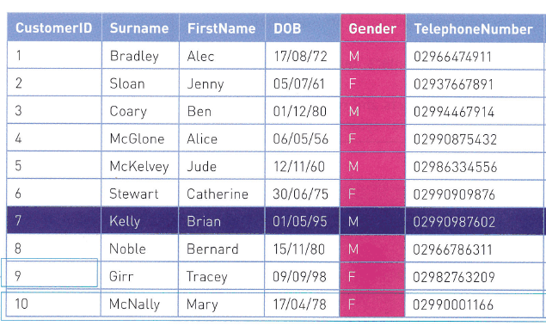
Table, Records and Fields
Data can be organised into a number of files.
These files can be organised into rows and columns, can can be referred to as a table or ‘flat file’
A table can consist of a number of rows, or records, which contain data items about an object or person
A field is part of a record that stores a single data item.
The field names are just another word for the headings at the top of the table
The Key Field (or primary key) is the field used to uniquely identify a record – In this table, the customerID can be used to identify any of the records (no customerID is repeated). (Most common datatype is autonumber)
Record
Field
Key Field
Field Name
Notes:
USE DEFINITIONS on next slide

Slide 5
Starting Glossary List
 Field
A single unit of data designed to hold a single item of information about an object or person, forming a column in a table.
 Key Field
Also known as a primary key. It is a unique field used to uniquely identify a record in a table.
 Table
A database structure where data is organised in rows and columns. Data stored in a database is held in one or more tables.
 Composite Key
A primary key which consists of two or more fields
 Record
 Foreign Key
A collection of related data items about an object or person, forming a complete row in a table. A record is made up of several fields.
When a primary key from one table appears as a field in a second table, it is known as a foreign key on the second table.

Slide 6

Queries
 A query is a way of searching, filtering and/or extracting data from a database to find answers to a question.
A query checks each record and produces a list of data that satisfies the query criteria.
To create a query, criteria are added to one or more fields in a table

Slide 7
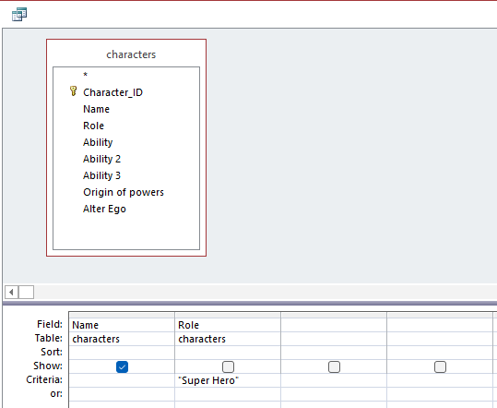
The table(s) are here
The fields you want to display / query from the table(s) go into their own columns here
Any criteria you want to use or add to the query can go here.

Slide 8
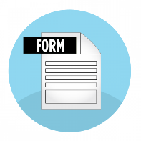
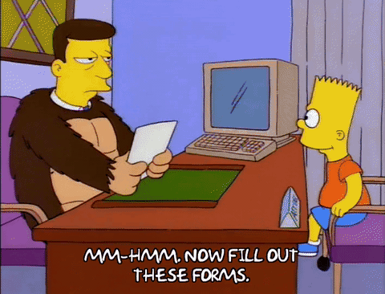
Forms

A common way to collect data from people and used to enter a new record, modify an existing record, or view existing records into a database table.
When user enters data, it stored the data in the correct table(s)
Database designer can control the type of data being entered and the format used to keep it consistent and accurate
Can be customised to include a logo and colour

Slide 9

Reports
Allows tables and results from queries to be presented in a user-friendly way
Layout of report can be customised
Easy to read and draw conclusions
Data can be presented by grouping similar data or even sorting in ascending/descending order

A database tool used to display, format, or print the results of processing or queries in a user-friendly format.

Slide 10

Macros
A small program written to perform a repetitive task automatically, usually at a click of a button.
Allow functionality to be added to both forms and reports, such as:
  Adding new record
  Deleting old records
  Updating existing
  CRUD (Create, read, update, delete functions)


Slide 11

Database Relationships
It is possible to link tables together in a database by using relationships
To do this, common fields have to appear in each table to allow the link to be made
The key field of one table needs to be stored in another table as a non-key field – known as a foreign key
There are three types of relationships;
One-to-One
one record maps to exactly one record in another table
One-to-Many
One record maps to many records in another table
Many-to-Many
Many records map to many, resolved through a junction table

Slide 12
An Example
Let’s create a database table with lots of Doctor information
And let’s have some details about patients in another table
patientID | FirstName | Age | Alergins
0001 | Peter | 15 | None
0002 | Stewart | 19 | Peanuts, Gluten
0003 | Tara | 14 | None
doctorID | FirstName | Location
A | Dr Wilson | Fermanagh
B | Dr Stewart | Tyrone
C | Dr Malone | Antrim
We know there is a link between these tables. As patients go and see the doctor.
We link them with a straight line.

Slide 13
A Worked Example
Let’s create a database table with lots of Doctor information
And let’s have some details about patients in another table
patientID | FirstName | Age | Alergins
0001 | Peter | 15 | None
0002 | Stewart | 19 | Peanuts, Gluten
0003 | Tara | 14 | None
doctorID | FirstName | Location
A | Dr Wilson | Fermanagh
B | Dr Stewart | Tyrone
C | Dr Malone | Antrim
We know there is a link between these tables. As patients go and see the doctor.
We link them with a straight line.

Slide 14
A Worked Example
We start at the beginning of this line.
patientID | FirstName | Age | Alergins
0001 | Peter | 15 | None
0002 | Stewart | 19 | Peanuts, Gluten
0003 | Tara | 14 | None
doctorID | FirstName | Location
A | Dr Wilson | Fermanagh
B | Dr Stewart | Tyrone
C | Dr Malone | Antrim
1
∞
So we put the many symbol here
Could relate to many different records here
Now we need to think about how these are related (also known as the cardinality of the relationship).
One record here (i.e. one doctor)
Basically is this one-one, one-many or many-to-many.

Slide 15
A Worked Example
patientID | FirstName | Age | Alergins
0001 | Peter | 15 | None
0002 | Stewart | 19 | Peanuts, Gluten
0003 | Tara | 14 | None
doctorID | FirstName | Location
A | Dr Wilson | Fermanagh
B | Dr Stewart | Tyrone
C | Dr Malone | Antrim
1
∞
1
1
One record here (i.e one patient)
Will only ever relate to a single record here (they only have one doctor)
Lets try that from the other side of the line now.

Slide 16
A Worked Example
And because we take the ‘higher’ cardinality, this is just the ‘many’ on this side
patientID | FirstName | Age | Alergins
0001 | Peter | 15 | None
0002 | Stewart | 19 | Peanuts, Gluten
0003 | Tara | 14 | None
doctorID | FirstName | Location
A | Dr Wilson | Fermanagh
B | Dr Stewart | Tyrone
C | Dr Malone | Antrim
1
∞
1
1
And this is just the same, we can just put the 1 here
Which means we have a one-to-many relationship here

Slide 17
A Worked Example
So instead of the infinity sign, they use this symbol
patientID | FirstName | Age | Alergins
0001 | Peter | 15 | None
0002 | Stewart | 19 | Peanuts, Gluten
0003 | Tara | 14 | None
doctorID | FirstName | Location
A | Dr Wilson | Fermanagh
B | Dr Stewart | Tyrone
C | Dr Malone | Antrim
1
∞
This is a common way of representing a one-to-many relationship
In some diagrams, you will see what is called a crows foot.

Slide 18

Enforcing Referential Integrity
Ensures data entered is consistent in both tables
This feature can be applied to the relationship between the table
It also ensures if the ‘parent’ table record is deleted, the records in the child table relating to the parent will also be deleted

Slide 19
Importing Data
Best to use a spreadsheet for importing data
Offers easy manipulation of data
Allows analysis of numerical data
A database can store several linked tables which makes consolidating and organising data even easier

Slide 20
Text | Mixture of text, numbers and symbols. Can store numbers that do not require calculations (such as phone number)
Number | Numeric data that requires a mathematical calculation
Date/Time | Dates and times
Currency | Monetary data (includes two decimal places)
Auto number | To create a key field, the computer generates sequential numbers automatically
Yes/No | Can be set to yes/no or True/false. Also known as a Boolean value
OLE Object | Object Linking and embedding. A file/object that has been created by software other than a database (i.e. word or spreadsheet document)
Hyperlink | Links to a web address (URL) or an email address
Attachment | Files are attached to a record (i.e. image)
Calculated | For the result of a calculation produced form another field in the record
Lookup Wizard | Creates a list of values. A value can be selected from a dropdown list and entered into the field.

Slide 21

Data Validation
A computer needs to automatically check data at the input stage to ensure it is reasonable, sensible and within acceptable limits.
Data validation guarantees that data is present and the correct type, range or length.
Data that does not conform to specified rules is rejected.
A number of data validation checks exist:
  Presence
  Length
  Type
  Format
  Range

Slide 22

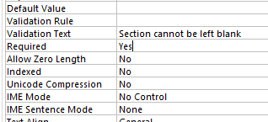
Presence Check
A check that ensures data has been entered into a required field and that no field is left blank.
Mainly used when we complete an online form
This can be achieved using required being set to Yes and Allow Zero Length to be set to No

Slide 23
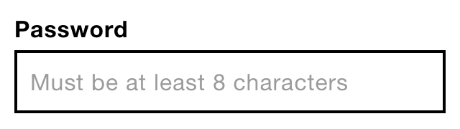
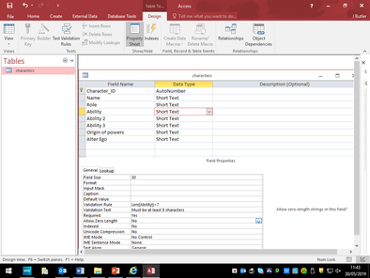
Length Check
A check that ensures data entered is no longer or shorter than a specified number of characters
Uses Len in the validation rule. In the example below, the Ability Field needs to be over 7 characters long.

Slide 24
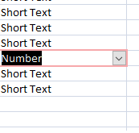
Type Check
Used to ensure data entered is of a specified data type
There are several different data types:
  Numeric (integer/double)
  Text (string/char)
  Date
  Etc

Slide 25
Format Check
Ensures data entered matches the predetermined pattern or structure.
We can use an input mask to ensure input is entered the same way for every record.
Imagine how many ways we can display the date, for example:
29th April 2018
29/4/2018
29 Apr 2018
29/04/18
04/29/18
29-04-18
29.04.18

Slide 26
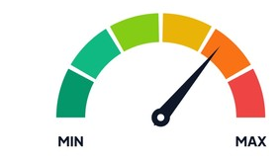
Range Check
Ensures data entered is within a lower limit and upper boundary limit.
For example, if a group should have a minimum of 5 and maximum of 20, the validation rule could be:
> 4 And <=20

Slide 27
Logical Operators
Comparison Operators
< | Less Than
<= | Less than or Equal to
> | Greater Than
>= | Greater Than or Equal to
= | Equal to
<> | Not Equal to
Comparing a value against other data is a typical operation when data is queried in a database.
Comparison Operators are used to allow this to be achieved
Also used to analyse two values and return either a true or false result.
These operators are denoted by words such as AND, OR, and BETWEEN

Slide 28
What is Big Data?
Big Data is large amounts of data that has the potential to be mined for information.
Unlike ‘normal’ data, big data cannot be analysed by normal means due to its:
  VOLUME
  VELOCITY
  VARIETY

Slide 29
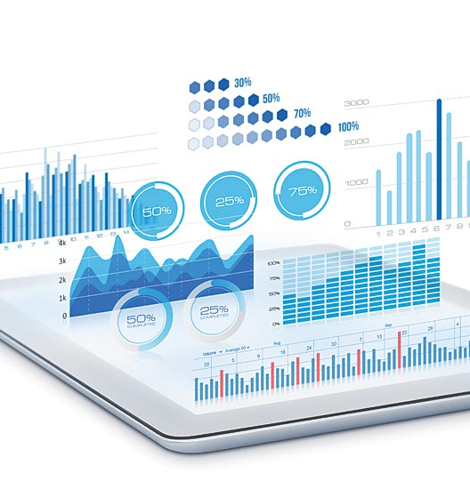
Volume
One of the reasons big data is termed big data is because there is large amounts of data stored by organisations
We know data is raw facts and figures with no meaning attached, and is unprocessed.
Organisations (such as Facebook and Google) now store large amounts of data from lots of different sources, and they have to be able to process this large amount of data in a suitable time
Imagine the number of posts Facebook or Twitter has each day – terabytes of data rather than just a few kilobytes!

Slide 30

Velocity
This is the speed at which data can be processed
Since there are such large volumes of data, and the expectation of ‘real time’ posting on social media (for example), powerful computers are required in order to actually process the data quickly.
Think – you wouldn’t want to submit a post on Instagram and it not actually post for hours afterwards. You would want it posted instantly or you would just move on to another social platform!

Slide 31

Variety
Organisations have to process lots of different types and varieties of data, including images, videos and sound clips – unlike just text (which is searchable), these formats require a different kind of analysis to gather data
Data can be structured, semi-structured or unstructured and organisations have to be able to gather data from all of these different types of data have to be stored sufficiently and correctly.
Think about what sort of data type you would need for a facebook post – it can have so many different types!!!

Slide 32
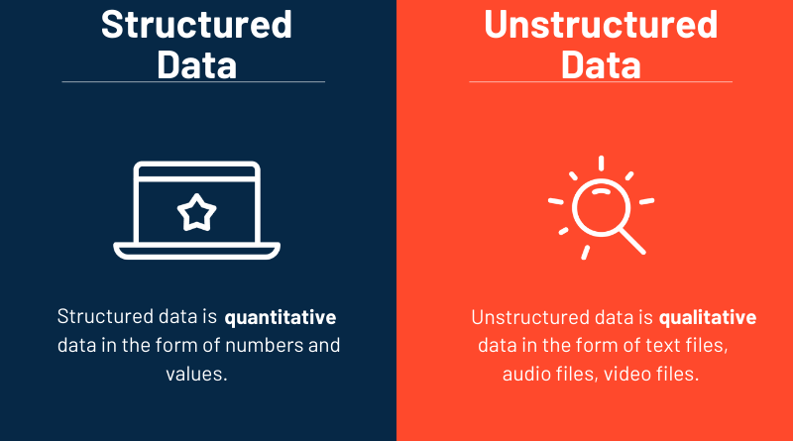
Structured data is also known as quantitative data
It is highly organised, usually in tabular format
Easily used and easily interpreted
Examples include, dates, names, addresses and credit card numbers
Structured data is also known as qualitative data
Cannot be processed by normal means using conventional data tools/methods
Easy to collect in ‘raw form’ and fast to collect
Examples include mobile activity, social media posts, IoT sensor data, essays

Slide 33

So how do you analyse such ?
We use data analytics
This is the process of analysing large volumes of data to produce useful information
Really important and beneficial for organisations to aid with decision making, especially when planning for future growth
Specialist software, called data mining software, and statistical analysis are designed to process these vast quantities of data
When data is in different formats (structured/unstructured), it makes preparing and processing data more challenging

Slide 34
Data Analytics
Data analytics is the application of algorithms, programs, or artificial intelligence to data to identify patterns, trends, and relationships, allowing conclusions to be drawn
This can assist with statistical analysis of the data using artificial intelligence in order to draw conclusions from multiple sources of information, including:
  Text, images and videos posted on social media sites;
  medical records;
  fitness monitors;
  financial markets – share price data, currencies, etc.;
  web server logs;
  mobile phone records;
  ecommerce transactions;
  device logs (internet of things).

Slide 35
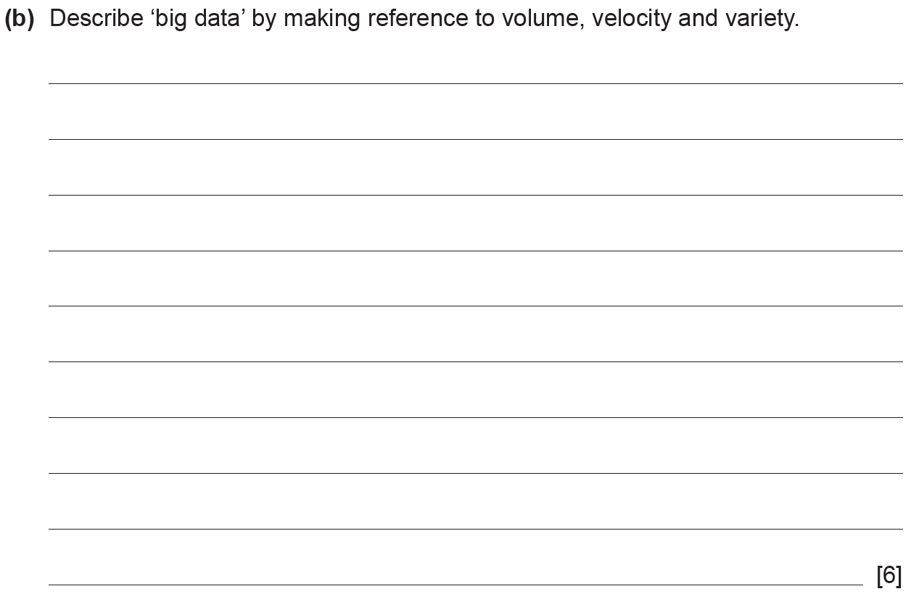

Slide 36
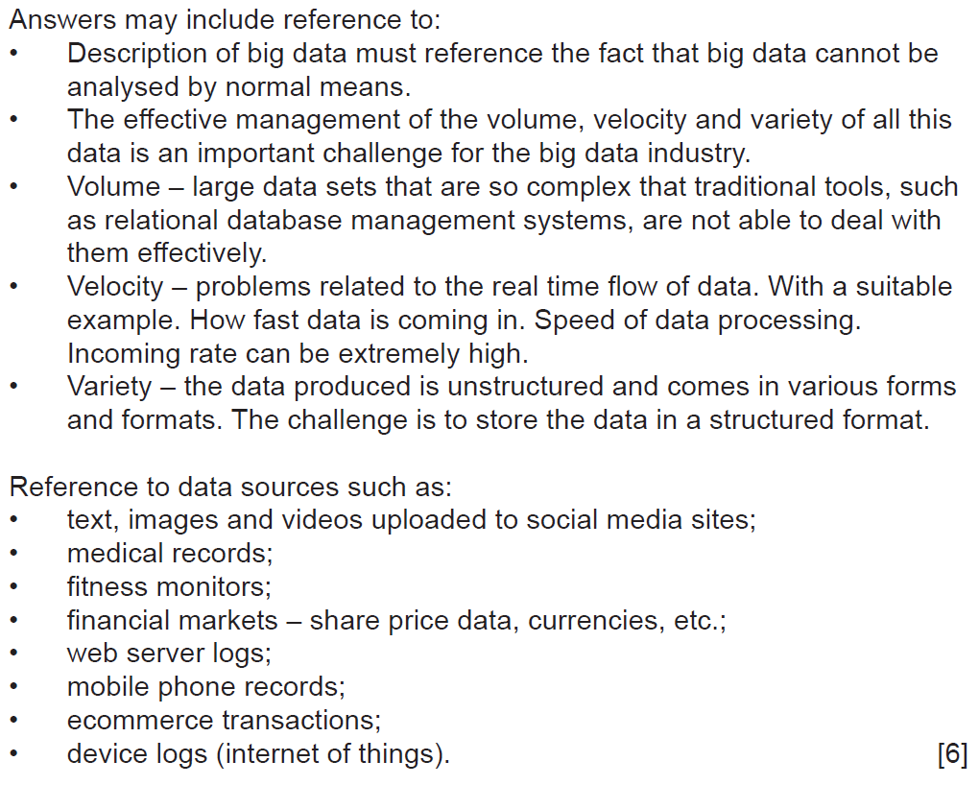
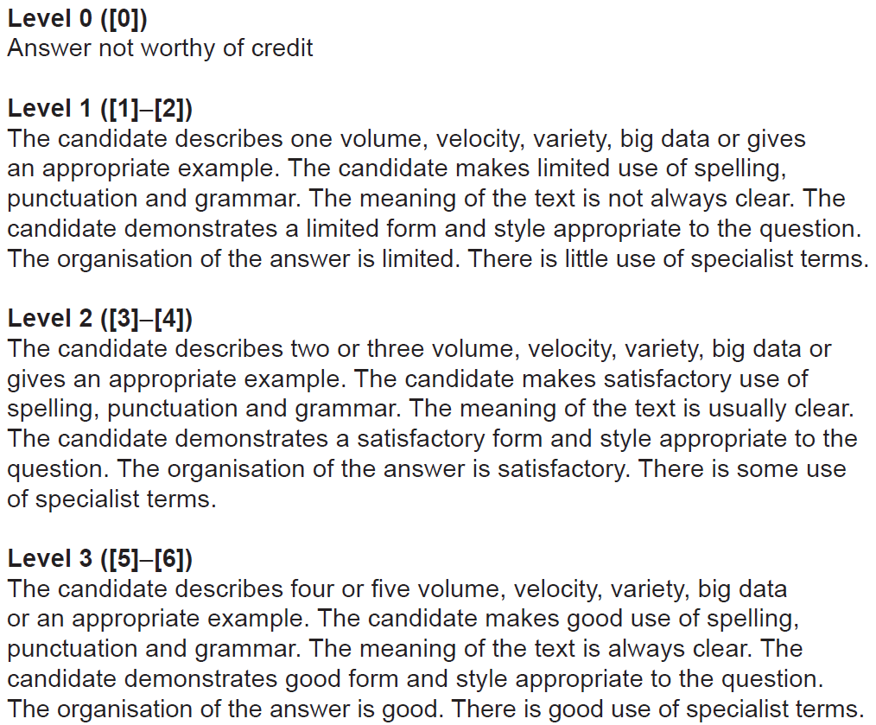

Slide 37
Suggested Answer
Big data is large amounts of data collected by companies in the form of text, images, social media posts, and fitness monitors which has the potential to be mined for information but cannot be analysed by normal means due to its volume, velocity and variety.
The volume of data refers to the large amounts of data, usually measured in terabytes or petabytes of data, that traditional tools are not able to deal with them effectively and specialist data mining software is required.
The large amounts of data arrives in quickly, which requires systems to process quickly and within a reasonable length of time. This is because the incoming rate can be extremely high.
The variety of data is also a cause for concern, as it can be structured or unstructured formats, creating a challenge to store the data in a structured format. This includes text, images and videos.

